Slide 1









How Can a Model Classify Text?
Text contains useful signals, but ML models need numerical features.
Raw Text
Numeric Features
Classifier
Prediction
"Congratulations! You won a free prize now!"
[0, 1, 1, 0,
1, ...]
Textmust beconverted into numbers
Spam
Classifier
→
→
→
Uses numerical features to predict a class
Predicted class
Words like "won", "free", and "prize" can help classify the message.
www.aiquest.org
2

Slide 2



Basic Probability
Probabilitymeasureshowoftenan event occurs
P(A) = outcomes in the event / total outcomes
Example: 100 people
40 sick
60 not sick
P(Sick) = 40 / 100 = 0.40
The denominator is the full group: all 100 people.
red dots = sick
gray dots = not sick
www.aiquest.org
3

Slide 3
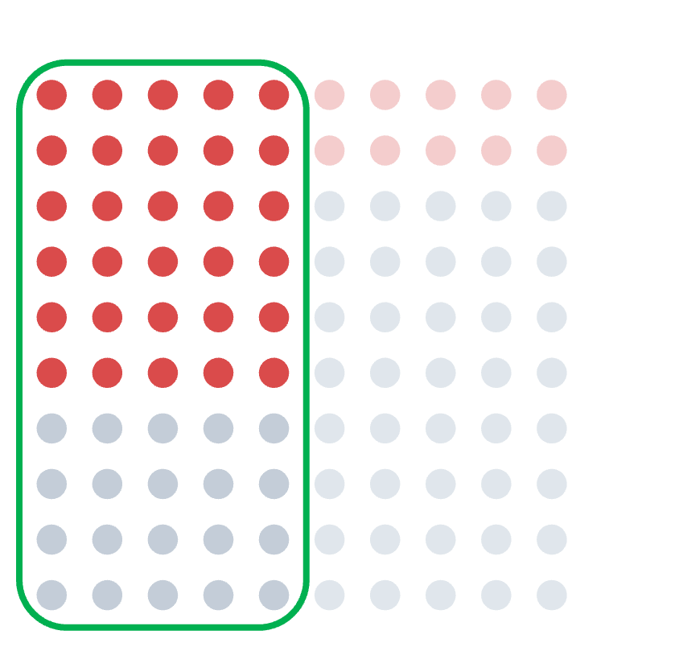



Conditional Probability
Newinformationchangesthegroupwearereasoning about
Given: the person is a
smoker
Now we only consider the 50 smokers.
50 smokers
P(Sick | Smoker) = 30 / 50 = 0.60
General formula
P(A | B)=P(A∩B) / P(B)
P(Sick | Smoker) = P(Sick ∩ Smoker) / P(Smoker) = (30 / 100) / (50 / 100) = 30 / 50 = 0.60
30 sick smokers
| means “given”
∩ means “and / both”
same 100 people as previous slide
www.aiquest.org
4

Slide 4



Bayes’ Theorem Reverses the Condition
Start from conditional probability
P(A | B) = P(A ∩ B) / P(B) P(B | A) = P(A ∩ B) / P(A)
Rearrange:
P(A ∩ B) = P(A | B) × P(B) P(A ∩ B) = P(B | A) × P(A)
Both expressions equal P(A ∩ B), so:
P(A | B) × P(B) = P(B | A) × P(A)
Divide by P(B):
P(A | B) = P(B | A) × P(A) / P(B)
www.aiquest.org
5

Slide 5

Bayes’ Theorem in Classification
In classification: A = the class we want to predict, B = the features we observe P(A | B) = P(B | A) × P(A) / P(B)
P(Class | features) = P(features | Class) × P(Class) / P(features)
P(Class | features)
— After seeing these features, how likely is this class? — How common are these features inside this class?
P(features | Class)
P(Class) P(features)
—Howcommon is this class in the training data? —Howcommon are these features overall?
For the same observed features, P(features) is the same denominator for every class. So, to decide which class is larger, compare only:
P(features | Class) × P(Class)
But how do we calculate P(features | Class) when there are many features?
www.aiquest.org
6

Slide 6

Naive Bayes Assumption
Treatfeaturesasconditionallyindependentoncethe class is known
The hard part is calculating the joint probability of many features.
Without the assumption P(x1, x2, x3 | y)
Estimate combinations together
Given the class y
P(x1 | y) × P(x2 | y) × P(x3 | y)
Treat feature probabilities as independent
Naive assumption
P(x1, x2, ..., xn | y) ≈ P(x1 | y) × P(x2 | y) × ... × P(xn | y)
“Naive” refers to this conditional-independence assumption.
www.aiquest.org
7

Slide 7
Naive Bayes Classification Formula
From Bayes in classification P(y | X) ∝ P(X | y) × P(y)
Using the naive assumption
P(X | y)≈P(x1 | y)×P(x2 | y)×...× P(xn | y)
Final Naive Bayes score
score(y) = P(y) × P(x1 | y) × P(x2 | y) × ... × P(xn | y)
Prediction: calculate this score for every class and choose the largest one.
ŷ = argmax_y P(y) × ∏ᵢ P(xᵢ | y)
www.aiquest.org
8

Slide 8


Let’s Build a Naive Bayes Classifier
Training data
New observation
Day 1
2
3
4
5
6
7
8
9 10
Weather Sunny
Sunny Rainy Sunny Cloudy Rainy Sunny Cloudy Rainy Sunny
Temp Mild
Hot Mild Mild Mild Hot Cool Hot Mild Mild
Play Yes
No Yes Yes Yes No No Yes Yes No
Weather = Sunny Temperature = Mild
Predict: Play = Yes or Play = No
We will first learn probabilities from the training table, then use only the needed ones for this new day.
www.aiquest.org
9

Slide 9











Training Step 1: Learn Class Probabilities
Training data
Count the Play labels
Day 1
2
3
4
5
6
7
8
9 10
Weather Sunny
Sunny Rainy Sunny Cloudy Rainy Sunny Cloudy Rainy Sunny
Temp Mild
Hot Mild Mild Mild Hot Cool Hot Mild Mild
Play Yes
No Yes Yes Yes No No Yes Yes No
Play = Yes: 6 rows Play = No: 4 rows
Class probabilities learned during training:
P(Yes) = 6 / 10 = 0.60
P(No) = 4 / 10 = 0.40
These class probabilities are stored and reused during prediction.

Slide 10





















Training Step 2: Learn Feature Probabilities
Training data
Weather probabilities
Temperature probabilities
Day 1
2
3
4
5
6
7
8
9 10
Weather Sunny
Sunny Rainy Sunny Cloudy Rainy Sunny Cloudy Rainy Sunny
Temp Mild
Hot Mild Mild Mild Hot Cool Hot Mild Mild
Play Yes
No Yes Yes Yes No No Yes Yes No
Weather Sunny
Rainy Cloudy
P(value | Yes) 2 / 6
2 / 6
2 / 6
P(value | No) 3 / 4
1 / 4
0 / 4
Temp Mild
Hot Cool
P(value | Yes) 5 / 6
1 / 6
0 / 6
P(value | No) 1 / 4
2 / 4
1 / 4
Example: among 6 Yes rows, Sunny appears 2 times, so P(Sunny | Yes) = 2/6.
Denominators are class counts: Yes = 6 rows, No = 4 rows.
Training calculates probabilities for every feature value, not only the values needed for the next prediction.
Some feature-class combinations have zero counts: P(Cloudy | No) = 0 and P(Cool | Yes) = 0.

Slide 11




Inference: Use the Needed Probabilities
New day
Naive Bayes score formula
Score(y) = P(y) × P(Sunny | y) × P(Mild | y)
Then substitute the values learned during training.
Weather = Sunny Temperature = Mild
For y = Yes
For y = No
Score(Yes) = P(Yes) × P(Sunny | Yes) × P(Mild | Yes)
= 6/10 × 2/6 × 5/6
≈ 0.167
Score(No) = P(No) × P(Sunny | No) × P(Mild | No)
= 4/10 × 3/4 × 1/4
= 0.075
0.167 > 0.075 → Predict Play = Yes
The same denominator P(Sunny, Mild) applies to both classes, so comparing scores is enough.

Slide 12












Types of Naive Bayes
Choosethevariantthatmatches the feature type
Naive Bayes variants differ by the kind of feature values they model.
Variant
Feature type
Typical example
Gaussian NB
Continuous numeric values
height, salary, sensor reading
Categorical NB
Discrete categories
weather, color, category
Multinomial NB
Counts or non-negative frequencies
Binary present / absent values
word counts, TF-IDF features
Bernoulli NB
word present = 1, absent = 0
Weather example: Categorical NB logic. Text classification: MultinomialNB with CountVectorizer / TF-IDF.
Choose the variant based on what the feature values represent.

Slide 13



NLP Fundamentals
Turninghumanlanguageintorepresentations a model can learn from
Natural Language Processing (NLP) helps computers work with human language.
→
→
Numerical Representation
Raw Text
Preprocessing
BoW • TF-IDF • WordEmbeddings
www.aiquest.org
14

Slide 14

Text Preprocessing
Cleanandstandardizetextbeforeextracting features
Raw text
FREE prize!!! Click NOW.
Lowercase
free prize!!! click now.
Remove punctuation
free prize click now
Tokenize
[free, prize, click, now]
Optional stopword removal
[free, prize, click]
Not every NLP task needs every preprocessing step; choose steps based on the model and problem.
www.aiquest.org
15

Slide 15

Stemming vs. Lemmatization
Stemming
Lemmatization
Rule-based chopping. Fast, but may produce non-words.
Uses vocabulary and grammar. Slower, but returns valid base forms.
word studies
wolves running
stem studi
wolv run
word studies
wolves better
lemma study
wolf good
Stemming is mechanical; lemmatization is more language-aware.
www.aiquest.org
16

Slide 16



Vectorization Converts Text into Numbers
Example document:
“free prize free now”
Bag of Words
Vocabulary: [free, prize, now, meeting]
TF-IDF
Same vocabulary
Word2Vec
A vector for each word
free → [0.12, -0.41, …] prize → [0.27, -0.18, …] now → [-0.05, 0.31, …]
[2, 1, 1, 0]
Document vector of raw counts “free” appears twice
[TF-IDF(free), TF-IDF(prize), TF-IDF(now), 0]
Weighted document vector Weights depend on the full corpus
Dense learned embeddings One vector per word
BoW and TF-IDF create document feature vectors. Word2Vec learns embeddings for individual words.
www.aiquest.org
17

Slide 17

Bag of Words Counts Words
Buildavocabulary,thencountwordoccurrencesineach document
Three short documents
Document-term matrix
D1: D2: D3:
free free prize now free offer now team meeting now
Doc D1
free 2
prize 1
offer 0
team 0
meeting 0
now 1
D2
1
0
1
0
0
1
Step 1: collect the vocabulary
Step 2: count each word in each document
D3
0
0
0
1
1
1
Columns = vocabulary words
|
Rows = documents
Bag of Words ignores word order; it keeps only the count of each vocabulary word.
www.aiquest.org
18

Slide 18



Multinomial Naive Bayes Learns from Word Counts
CountsareusedtoestimateP(word | Class)
Training word counts
Convert counts to probabilities
Class Spam
Not Spam
free 8
0
prize 5
0
offer 6
0
meeting 0
9
Before smoothing:
P(free | Spam) = 8 / 19
P(prize | Spam) = 5 / 19 P(offer | Spam) = 6 / 19 P(prize | Not Spam) = 0 / 9 = 0
Total word count in Spam = 8 + 5 + 6 + 0 = 19 Total word count in Not Spam = 0 + 0 + 0 + 9 = 9
“free prize offer”
:
For the message
Score(Spam)=P(Spam) × P(free | Spam) × P(prize | Spam) × P(offer | Spam)
Score(Not Spam) contains P(prize | Not Spam) = 0
Therefore the whole Not Spam score becomes 0.
This zero-probability problem is why we use smoothing.
www.aiquest.org
19

Slide 19
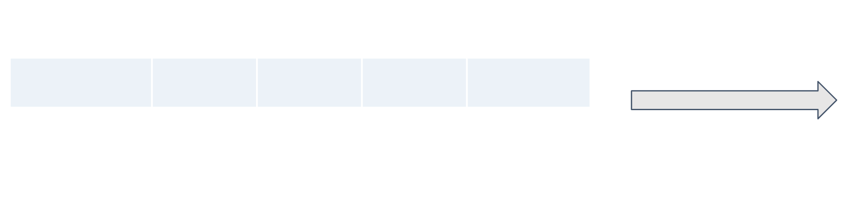


Laplace Smoothing Fixes Zero Probabilities
Before smoothing
After smoothing
Class Spam
free 8
prize 5
offer 6
meeting 0
Class Spam
free 9
prize 6
offer 7
meeting 1
+1 to every vocabulary count
Not Spam
0
0
0
9
Not Spam
1
1
1
10
General formula
P(word | Class) = (count(word,Class)+1) / (total word count in Class + V)
V = number of words in the vocabulary
Example: word “prize” inside the Not Spam class
Here: count(prize,NotSpam)=0|
totalwordcountinNotSpam=9 | V = 4
P(prize | Not Spam) = (0 + 1) / (9 + 4) = 1 / 13
Smoothing prevents one zero count from making the whole Naive Bayes score zero.
www.aiquest.org
20

Slide 20



TF-IDF Gives More Weight to Informative Words
Same three documents as Bag of Words
Document frequency → IDF intuition
D1: D2: D3:
free free prize now free offer now team meeting now
prize
1 of 3 documents
higher IDF
free
2 of 3 documents
medium IDF
now
3 of 3 documents
lowest IDF
TF-IDF = Term Frequency × Inverse Document Frequency
A word that appears everywhere is less useful for distinguishing documents.
www.aiquest.org
21

Slide 21

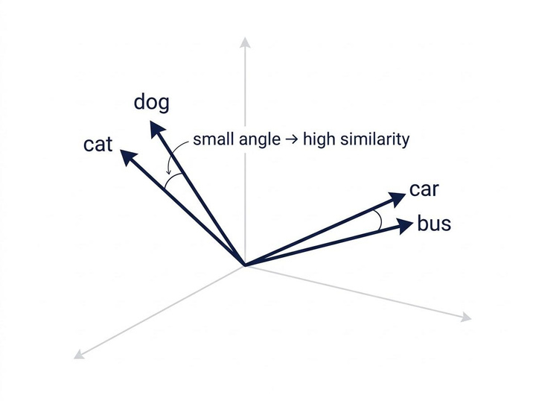


Word2Vec Learns Word Embeddings
word → dense vector
king → [0.21, -0.63, 0.14, …]
Each word gets a learned numeric vector. The vector is learned from surrounding word context.
Words used in similar contexts tend to have similar
vector directions.
Similarity is commonly measured using cosine similarity.
www.aiquest.org
22

Slide 22



Let's Implement It with Python
CountVectorizerandMultinomialNBinsideoneleakage-safe pipeline
from sklearn.model_selection import train_test_split
from sklearn.feature_extraction.text import CountVectorizer
from sklearn.naive_bayes import MultinomialNB from sklearn.pipeline import make_pipeline
Vectorizer
CountVectorizer learns the vocabulary from X_train and turns messages into word-count rows.
Model
MultinomialNB scores each class from those counts. Laplace smoothing is built in.
X_train, X_test, y_train, y_test = train_test_split(
X, y, test_size=0.2, stratify=y,
random_state=42 )
Onepipeline
The vectorizer and model are fitted only on training data, then evaluated once on X_test.
model = make_pipeline(CountVectorizer(), MultinomialNB())
model.fit(X_train, y_train) print(model.score(X_test, y_test))
www.aiquest.org
26

